Slide 1
Lesson 3.18
The International Compensation Regime
CGPRT(W) : Ensuring Clean Seas and Coasts in Western Region ……

Slide 2
Objective
To understand:
the international compensation regimes;
the rationale behind the systems;
the advantages of ratification; and
the amounts available.
CGPRT(W) : Ensuring Clean Seas and Coasts in Western Region ……

Slide 3
Compensation and Liability Regimes
National law governs liability and compensation in a particular country
National funds (USA, China, Canada)
Limitation Convention 1976 or 1996 (LLMC)
Bunkers Convention 2001
Civil Liability Convention 1992
Fund Convention 1992
Supplementary Fund Convention 2002
2010 HNS Convention
CGPRT(W) : Ensuring Clean Seas and Coasts in Western Region ……

Slide 4
Polluter Pays Principle
The majority of countries around the world have adopted the “polluter pays principle”
In the case of oil spills the costs can be thought of as preparedness and response,
The majority of countries worldwide fund the preparedness from general taxation, private sector or special fund
Response costs are claimed from the insurer or international Fund
CGPRT(W) : Ensuring Clean Seas and Coasts in Western Region ……

Slide 5
National laws
Variable rules and limits
Application dependent on national legal system
Compensation amounts and rules vary
Claims falling outside the international conventions may be covered by national law
Examples of countries with national legislation designed to supplement the international conventions:
  China: Domestic Pollution Fund to supplement international conventions (except Hong Kong, China)
  Canada: Ship-source oil pollution fund - supplements and complements international conventions
Examples of national legislation governing liability and compensation where the international conventions have not been adopted:
  USA: Common Federal Law OPA 90/Variable States Laws
CGPRT(W) : Ensuring Clean Seas and Coasts in Western Region ……

Slide 6
International Conventions
Uniform application
Provide compensation to victims of pollution damage
Applies to damage caused on the territory, including the territorial sea, and in exclusive economic zones of member states .
Strict (no fault) liability
Right to limit broken only in a limited number of circumstances
CGPRT(W) : Ensuring Clean Seas and Coasts in Western Region ……

Slide 7
International Conventions
Limitation of liability based on the size of the vessel under CLC 1992 and Bunkers 2001.
Compensation through amicable settlements potentially avoiding court settlement
Equal treatment of claimants regardless of nationality
CGPRT(W) : Ensuring Clean Seas and Coasts in Western Region ……

Slide 8
International Conventions
Maximum compensation available is fixed under the Convention to a sum of Special Drawing Rights “SDR”.
Ensures a consistent approach to compensation in every member state.
CGPRT(W) : Ensuring Clean Seas and Coasts in Western Region ……

Slide 9
Convention on Limitation of Liability for Maritime Claims (LLMC 1976 and 1996)
CGPRT(W) : Ensuring Clean Seas and Coasts in Western Region ……

Slide 10
LLMC
Shipowners and salvors may limit their liability
Except if "it is proved that the loss resulted from his personal act or omission, committed with the intent to cause such a loss, or recklessly and with knowledge that such loss would probably result”
CGPRT(W) : Ensuring Clean Seas and Coasts in Western Region ……

Slide 11
LLMC
The persons entitled to limit liability are:
  shipowners
  charterers
  managers
  operators
  salvors
  any person for whose act, neglect or default the parties identified in 1–5 are responsible employees
  insurers of liability of the parties identified above
of a sea-going ship
CGPRT(W) : Ensuring Clean Seas and Coasts in Western Region ……

Slide 12
LLMC 1996
The limit of liability for claims for loss of life or personal injury for ships not exceeding 2,000 gross tonnage is 2 million SDR
For property claims for ships not exceeding 2,000 gross tonnage is 1 million SDR
For larger ships,
* For each ton from 2,001 to 30,000 tons, 800 SDR
* For each ton from 30,001 to 70,000 tons, 600 SDR
* For each ton in excess of 70,000 tons, 400 SDR
(example: 150,000 ton ship: 80,400,000 SDR)
CGPRT(W) : Ensuring Clean Seas and Coasts in Western Region ……

Slide 13
International Convention on Civil Liability for
Bunker Oil Pollution Damage, 2001
CGPRT(W) : Ensuring Clean Seas and Coasts in Western Region ……

Slide 14
Bunker Convention
To ensure that adequate, prompt, and effective compensation is available to persons who suffer damage caused by spills of oil carried as fuel in ships’ bunkers.
Applies to damage caused on the territory, including the territorial sea, and in exclusive economic zones of States Parties.
CGPRT(W) : Ensuring Clean Seas and Coasts in Western Region ……

Slide 15
Bunker Convention
“Pollution damage” means
  loss or damage caused outside the ship by contamination resulting from the escape or discharge of bunker oil from the ship, wherever such escape or discharge may occur, provided that compensation for impairment of the environment other than loss of profit from such impairment shall be limited to costs of reasonable measures of reinstatement actually undertaken or to be undertaken; and
  the costs of preventive measures and further loss or damage caused by preventive measures.
CGPRT(W) : Ensuring Clean Seas and Coasts in Western Region ……

Slide 16
Bunker Convention
Strict liability for shipowner.
Applies to any hydrocarbon mineral oil/lubricating oil used/intended for operation or propulsion of a ship.
Shipowner may limit liability under an applicable national law but cannot exceed that international regime, e.g. LLMC 1976 or 1996 as applicable.
Owners of ships with g.r.t > 1,000 tonnes must maintain insurance to cover liability for pollution damage “bunkers certificate”.
CGPRT(W) : Ensuring Clean Seas and Coasts in Western Region ……

Slide 17
Insurers and P&I Clubs
Compensation under 1992 CLC and Bunkers 2001 paid by the insurer of the vessel.
The insurer is usually a Protection and Indemnity (P&I) Club.
P&I Clubs insure a vessel’s third party liabilities on a mutual basis.
Costs are shared between shipowners in a Club and between Clubs that comprise the International Group of P&I Clubs
CGPRT(W) : Ensuring Clean Seas and Coasts in Western Region ……

Slide 18
1992 Civil Liability and Fund Conventions
CGPRT(W) : Ensuring Clean Seas and Coasts in Western Region ……

Slide 19
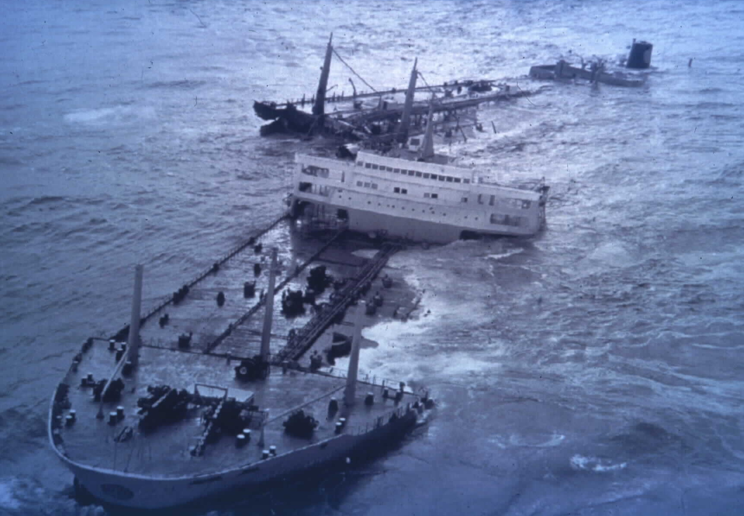
Torrey Canyon, March 1967
CGPRT(W) : Ensuring Clean Seas and Coasts in Western Region ……
Notes:
Oil Spill Compensation System & ITOPF
Mark Whittington, ITOPF Technical Adviser
19
TORREY CANYON (United Kingdom, 1967)
TORREY CANYON ran aground on Pollard Rock on the Seven Stones Reef, near Lands End, Cornwall on 18 March 1967. Thousands of tonnes of oil were soon spilling from the stricken vessel's ruptured tanks and during the next 12 days the entire cargo of approximately 119,000 tonnes of Kuwait crude oil was lost.
A wide variety of methods to mitigate the spill were tried. Burning the slick proved unsuccessful, and eventually the British Government gave orders for TORREY CANYON to be destroyed by aerial bombardment in the hope that all the oil still remaining on board would be burnt off. This operation was partially successful, but did not prevent escaping oil from polluting many parts of the south west of England, causing the deaths of thousands of seabirds and threatening the livelihoods of many local people in the forthcoming summer tourist season. Later the drifting oil polluted beaches and harbours in the Channel Islands and Brittany.
A distinguishing feature of the TORREY CANYON response operation was the excessive and indiscriminate use of early dispersants and solvent based cleaning agents, which caused considerable environmental damage. The dispersants were generally successful at their task of reducing the amount of oil arriving ashore and subsequently expediting onshore cleanup operations, but they were considerably more toxic than those used today and were applied in far greater concentrations, often being poured undiluted on slicks and beaches. Many of the detrimental impacts of the spill were later related to the high volume, high concentration and high toxicity of the dispersant and detergents used.
The TORREY CANYON was the first major tanker disaster to be brought to the notice of the general public due to enormous media coverage, and drew universal attention to the dangers of dispersants. The spill triggered the international Conventions, which form the basis for compensation for damage caused by tanker spills, and interim voluntary agreements to bridge the gap before the Conventions entered into force and became widely accepted.

Slide 20
Civil Liability and Fund Conventions
Torry Canyon incident in international waters affecting multiple states
Shipowner and operator not based in affected states and compensation difficult to obtain.
Limited compensation recovered but only through prolonged legal process and arrest of other assets.
CGPRT(W) : Ensuring Clean Seas and Coasts in Western Region ……

Slide 21
Civil Liability and Fund Conventions
Political motivation to develop a system applicable to all persistent oil spills which will ensure equal treatment of all victims regardless of nationality or status and through simply legal process.
CGPRT(W) : Ensuring Clean Seas and Coasts in Western Region ……

Slide 22
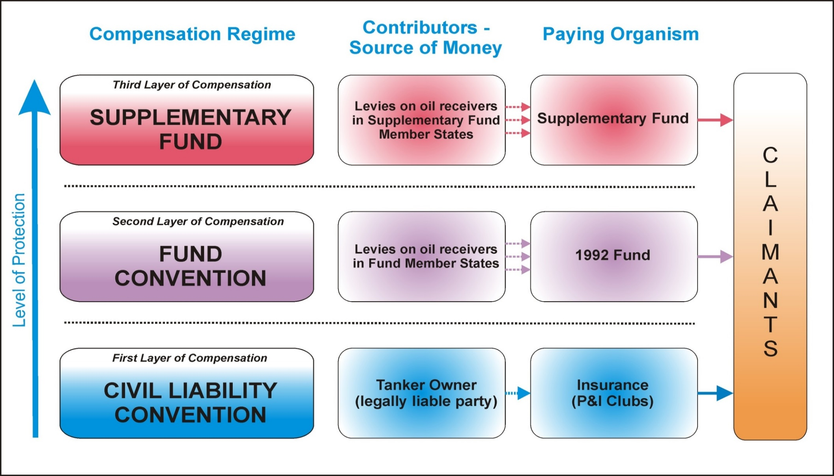
The Three Tier System
CGPRT(W) : Ensuring Clean Seas and Coasts in Western Region ……

Slide 23
CLC and Fund 1992
Pollution damage
Spills of persistent oil from tankers
Territory, territorial waters and EEZ or equivalent
Preventive measures
Bunker spills from unladen tankers with residues of persistent cargo on board
“Mystery spills” from a tanker
CGPRT(W) : Ensuring Clean Seas and Coasts in Western Region ……

Slide 24
CLC 1992 – 1st Tier
Strict Liability of registered shipowner
Limitation of Liability (based on the gross tonnage)
Shipowners may lose right of limitation
Shipowners required to have compulsory third party insurance and certificate
Direct action against insurer of the ship
CGPRT(W) : Ensuring Clean Seas and Coasts in Western Region ……
Notes:
24
24

Slide 25
Pollution Damage
Loss or damage caused outside the ship by contamination resulting from the escape or discharge of oil from the ship, wherever such escape or discharge may occur, provided that compensation for impairment of the environment other than loss of profit from such impairment shall be limited to costs of reasonable measures of reinstatement actually undertaken or to be undertaken;
The costs of preventive measures and further loss or damage caused by preventive measures.
CGPRT(W) : Ensuring Clean Seas and Coasts in Western Region ……

Slide 26
CLC 1992
Incident
Art I.8
Preventive measures Art I.7
Any occurrence or series of occurrences having the same origin, which causes pollution damage or creates a grave and imminent threat of causing such damage
Any reasonable measures taken by any person after an incident has occurred to prevent or minimize pollution damage
CGPRT(W) : Ensuring Clean Seas and Coasts in Western Region ……

Slide 27
Right to limit Liability
Shipowner loses this right if it is proved that the damage resulted from the owner’s personal act or omission, committed with the intent to cause damage or recklessly with the knowledge that such damage would probably result.
CGPRT(W) : Ensuring Clean Seas and Coasts in Western Region ……

Slide 28
Right to limit Liability
Shipowner exempt if damages:
Resulted from act of war, hostilities, civil war, insurrection, or a grave natural disaster
Wholly caused by an act or omission done with intent to cause damage by a third party
Wholly caused by negligence or other wrongful act of public authorities in maintaining navigational aids
CGPRT(W) : Ensuring Clean Seas and Coasts in Western Region ……

Slide 29
CLC 1992
Limit of Shipowner’s Liability
G.R.T. | SDR
≤ 5000 | 4 510 000
Per additional GT up to 140 000 | 631/tonne
GT ≥ 140 000 | 89 770 000
CGPRT(W) : Ensuring Clean Seas and Coasts in Western Region ……

Slide 30
1992 Fund Convention
Provides compensation for pollution damage to the extent that the compensation available under the 1992 CLC is inadequate
Creates an intergovernmental organization: the IOPC Fund
Maximum compensation 203 million SDR, including amounts payable under 1992 CLC
Contributions to Fund payable by oil receivers in member States.
CGPRT(W) : Ensuring Clean Seas and Coasts in Western Region ……

Slide 31
1992 Fund Convention
Applies if
  Damage occurs in a member state
  Shipowner exempt under 1992 CLC
  Shipowner financially incapable of meeting obligations
  Damage exceeds the shipowner’s liability
Does not apply if
  Damage caused by an act of war or spill from warship
  Claimant cannot prove oil originated from a “ship” as defined in the Conventions (“mystery spills”)
CGPRT(W) : Ensuring Clean Seas and Coasts in Western Region ……

Slide 32
1992 Fund Convention
The International Oil Pollution Compensation Fund 1992 and the Supplementary Fund are administered by a secretariat based in London
The secretariat undertakes a number of activities, including:
administering claims and making payments for reasonable losses
levying contributions on receivers of oil in Member States
CGPRT(W) : Ensuring Clean Seas and Coasts in Western Region ……

Slide 33
3rd TIER
SUPPLEMENTARY FUND 2003
Introduced following the Erika and Prestige incidents where claims submitted exceeded the maximum compensation available
Maximum compensation 750 million SDR, including amounts payable under 1992 Conventions
Contributions to Supplementary Fund payable by oil receivers in States Parties to Protocol (= identical to 1992 Fund)
CGPRT(W) : Ensuring Clean Seas and Coasts in Western Region ……

Slide 34
Who Contributes to the Funds?
Oil receivers pay, not governments
Person receiving > 150 000 tons of contributing persistent oil (crude oil and heavy fuel oil)/year after sea transport
Level of contributions levy decided by Fund Assembly based on compensation to be paid.
CGPRT(W) : Ensuring Clean Seas and Coasts in Western Region ……

Slide 35
The three tier System
CGPRT(W) : Ensuring Clean Seas and Coasts in Western Region ……

Slide 36
Admissibility of Claims − Principles
No claims manual for Bunkers 2001 or CLC 1992.
IOPC Funds claims manual is normally applied, being accepted as internationally agreed principles, but may be overruled by national courts.
Shipowners, P&I Clubs and IOPC Funds all provide information, training and experts on site to advise governments, responders and claimants on admissibility and preparation of claims.
CGPRT(W) : Ensuring Clean Seas and Coasts in Western Region ……

Slide 37
Admissibility of Claims − Principles
Sufficiently close link of causation between the contamination and the loss
Claimant must prove loss or damage
Loss/damage must be economically quantifiable and actually suffered
Any expense must be for measures which are reasonable and justifiable
CGPRT(W) : Ensuring Clean Seas and Coasts in Western Region ……

Slide 38
Main Types of Claims
Property damage
Clean-up operations and preventive measures
Losses in fishery, mariculture and tourism sectors
Environmental damage (costs of reasonable measures of reinstatement)
It is for the claimant to prove the loss
Theoretical model and future losses are not considered
CGPRT(W) : Ensuring Clean Seas and Coasts in Western Region ……

Slide 39
Time bar
Article VIII − 1992 CLC
  Rights of compensation shall be extinguished unless:
  An action is brought within three years from the date when the damage occurred.
  In no case shall an action be brought after six years from the date of the incident.
CGPRT(W) : Ensuring Clean Seas and Coasts in Western Region ……

Slide 40
Time bar
Article 6 − 1992 Fund Convention
  Rights to compensation shall be extinguished unless:
  action is brought within three years from date of damage; or
  notification to 1992 Fund is made of a court action against the shipowner or insurer within three years of damage;
  In no case shall an action be brought after six years from the date of the incident.
CGPRT(W) : Ensuring Clean Seas and Coasts in Western Region ……

Slide 41
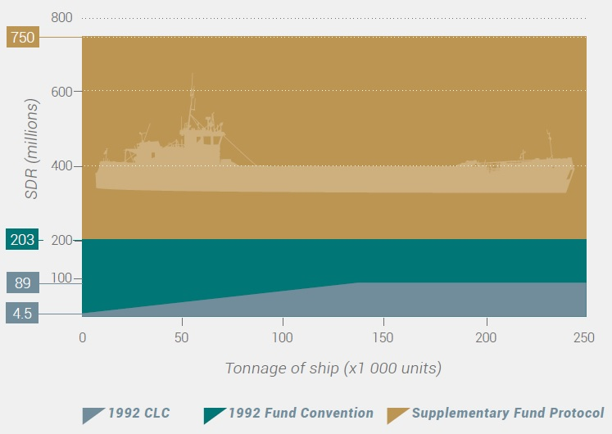
Maximum Limits of Compensation
Source: IOPC Funds
CGPRT(W) : Ensuring Clean Seas and Coasts in Western Region ……

Slide 42
HNS Convention
The International Convention on Liability and Compensation for Damage in Connection with the Carriage of Hazardous and Noxious Substances by Sea (HNS Convention) was originally adopted at an International Conference organized by IMO in 1996
Amended by a Protocol in 2010
Not yet entered into force (as of May 2017)
CGPRT(W) : Ensuring Clean Seas and Coasts in Western Region ……

Slide 43
HNS Convention
To ensure adequate compensation is available for damage occurring as a result of the maritime transport of hazardous and noxious substances (HNS).
The HNS Convention covers:
  any damage in the territory or territorial sea of a State Party to the Convention;
  pollution damage in the exclusive economic zone (EEZ), or equivalent area, of a Member State; and
  damage (other than pollution damage) caused by HNS carried on board ships registered in the flag of the Member State outside the territorial sea of any State.
CGPRT(W) : Ensuring Clean Seas and Coasts in Western Region ……

Slide 44
HNS Convention
The following types of damage will be covered:
  Loss of life or personal injury on board or outside the ship carrying the HNS;
  Loss of or damage to property outside the ship;
  Economic losses resulting from contamination, e.g. in the fishing, mariculture and tourism sectors;
  Costs of preventive measures, e.g. clean-up operations at sea and onshore; and
  Costs of reasonable measures of reinstatement of the environment.
Claims under the HNS Convention will be assessed according to criteria that will be established by the Governments of the States Parties.
CGPRT(W) : Ensuring Clean Seas and Coasts in Western Region ……

Slide 45
HNS Convention
Limitation for compensation
Maximum 250 million SDR in compensation (including any amount paid by the shipowner and his/her insurer) will be available under the HNS Fund.
Where damage is caused by HNS in bulk, the shipowner will normally be able to limit his/her financial liability to an amount between 10 million and 100 million SDR, depending on the gross tonnage of the ship.
Where damage is caused by packaged HNS, the maximum liability for the shipowner is 115 million SDR.
In any case, once the shipowner’s limit has been reached, the HNS Fund will step in with the additional tier of compensation.
CGPRT(W) : Ensuring Clean Seas and Coasts in Western Region ……

Slide 46
HNS Convention
Source: IOPC Funds
CGPRT(W) : Ensuring Clean Seas and Coasts in Western Region ……

Slide 47
HNS Convention
The shipowner will have strict liability for any damage caused by HNS, i.e. the shipowner will be liable even without fault on the part of the ship or its crew.
The shipowner will be obliged to maintain insurance to cover his liabilities under the HNS Convention. This insurance will normally be provided by protection and indemnity (P&I) insurers.
CGPRT(W) : Ensuring Clean Seas and Coasts in Western Region ……

Slide 48
HNS Convention
The HNS Fund
Will be established once the HNS Convention enters into force. States which ratify the 2010 HNS Protocol will become Members of the HNS Fund.
Will provide the second tier of compensation and will be administered by a Secretariat and headed by a Director.
Expected to function similarly to the IOPC Funds and will be governed by an Assembly composed of Government representatives from its Member States.
Will also have a Committee to address claims for compensation, which will be similar to the IOPC Fund’s Executive Committee.
CGPRT(W) : Ensuring Clean Seas and Coasts in Western Region ……

Slide 49
HNS Convention
How will the HNS Fund be financed?
The HNS Fund will be financed by contributions paid by receivers of bulk HNS, or titleholders for LNG cargo in some cases, that have been transported by sea to the ports and terminals of Member States.
The HNS Fund will have up to four accounts, with separate accounts for oil, LNG and LPG and a general account for bulk solids and other HNS. However, until the quantities of HNS received in all States Parties reach the established thresholds, as shown in the table on the next slide, all accounts will be managed out of the general account.
Contributions by individual receivers to the separate accounts and sectors will be in proportion to the quantities of HNS received, provided that the quantities are above the established thresholds.
Whereas the total contributions to the general account will be divided amongst the sectors, according to the level of claims in each sector, the separate accounts will only meet claims resulting from incidents involving the respective cargoes, i.e. there will be no cross-subsidization.
As part of the changes agreed in the 2010 HNS Protocol, packaged goods will no longer be considered as contributing cargo to the HNS Fund. However, compensation for incidents involving packaged HNS will continue to be covered under the relevant account.
CGPRT(W) : Ensuring Clean Seas and Coasts in Western Region ……

Slide 50
HNS Convention
Source: IOPC Funds
CGPRT(W) : Ensuring Clean Seas and Coasts in Western Region ……

Slide 51
Conclusion
There are a number of national laws and international liability and compensation regimes which your country may have adopted.
The compensation available will depend on which Conventions have been ratified and are applicable to this incident and the vessel size and type.
CGPRT(W) : Ensuring Clean Seas and Coasts in Western Region ……

Slide 52
Conclusion
In return for accepting strict liability which simplifies the compensation process the shipowers in most cases can limit liability to an agreed amount.
Compensation is paid only for proven losses
CGPRT(W) : Ensuring Clean Seas and Coasts in Western Region ……

Slide 53
Any questions?
CGPRT(W) : Ensuring Clean Seas and Coasts in Western Region ……

